Slide 1
The bet-ter choice: exploring putative dopamine effects on cost-benefit decision making
4.23.2019
Guillaume Pagnier

Slide 2
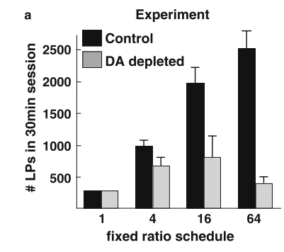
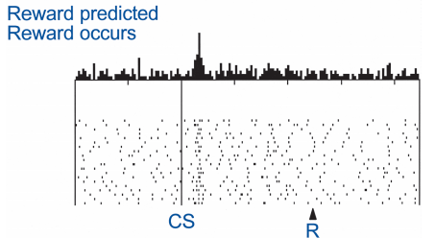
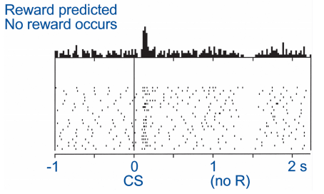
What does dopamine (DA) do?
Lots of things
Future behavior (learning)
Current behavior (performance)
Fast, phasic DA spikes in the striatum occur when participants experience reward prediction errors and modulate learning.
DA lesions leads to akinetic movements and the choice to not pursue rewards
Shultz et al., 1997
Aberman & Salamone 1999
Notes:
Dual aspect of DA

Slide 3
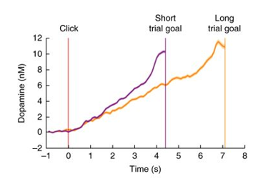
Striatal DA ramps as animals approach a reward
Collins et al., 2016
Howe et al., 2013
Hamid et al., 2016

Slide 4
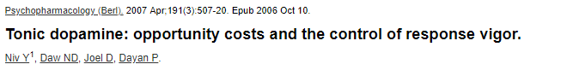
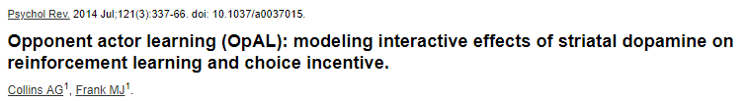
Consequences of high mesolimbic DA
Indiscriminately increasing vigor of any action
Modulates perceived rewards and/or perceived costs
Notes:
OpAL integrates the two purposes of DA I mentioned at the first slide: learning and choice and says that they’re not independent at all, they actually interact with one another.

Slide 5
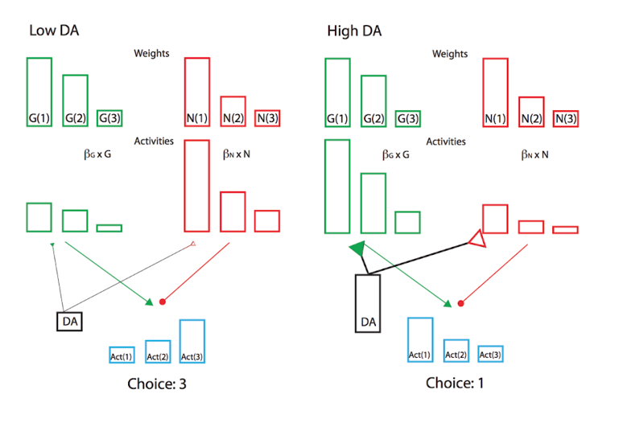
Do fluctuating levels of DA bias value perception?
At different levels of DA, participants may be perceiving value differently.
High DA -> high emphasis on rewards
i.e. participants should prefer risky gambles and respond
faster as the potential reward is higher
Notes:
Coffee, tea example? Gambles are a good way to probe this as they offer an unambiguous higher reward with a higher potential loss.

Slide 6
Do humans’ propensity to gamble / speed vary as striatal DA changes?

Slide 7
How to elicit DA ramp?
Gamble?
Gamble?
Gamble?
Howe et al., 2013

Slide 8
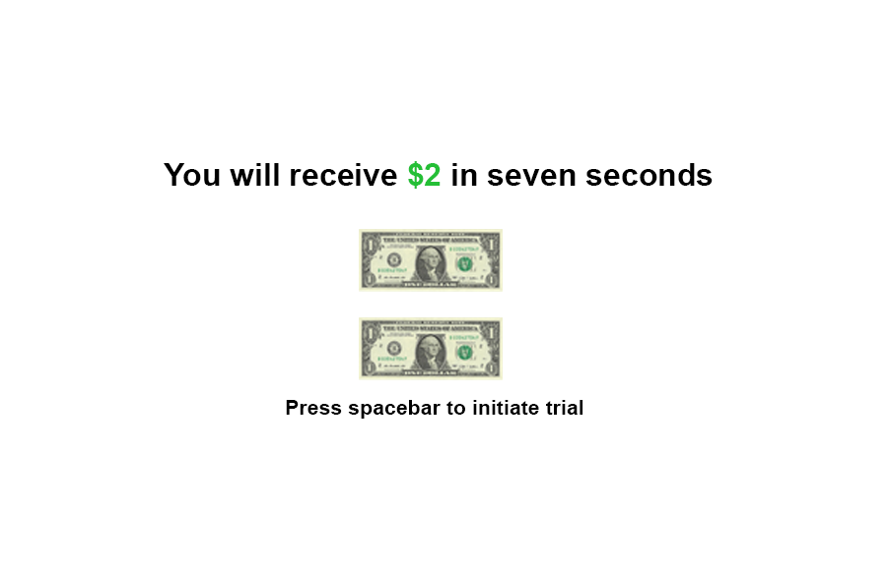
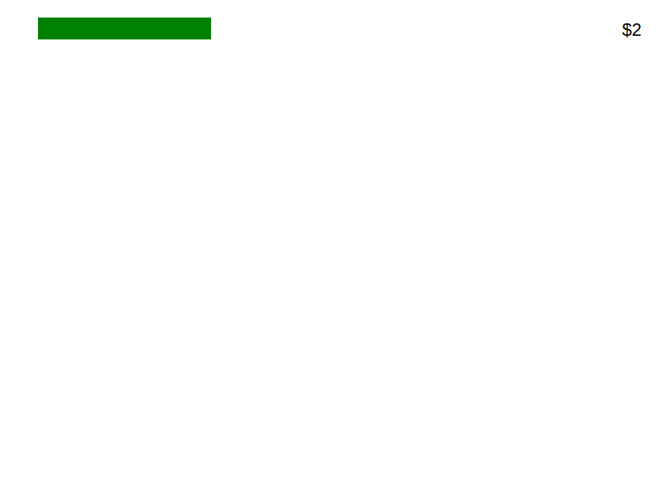
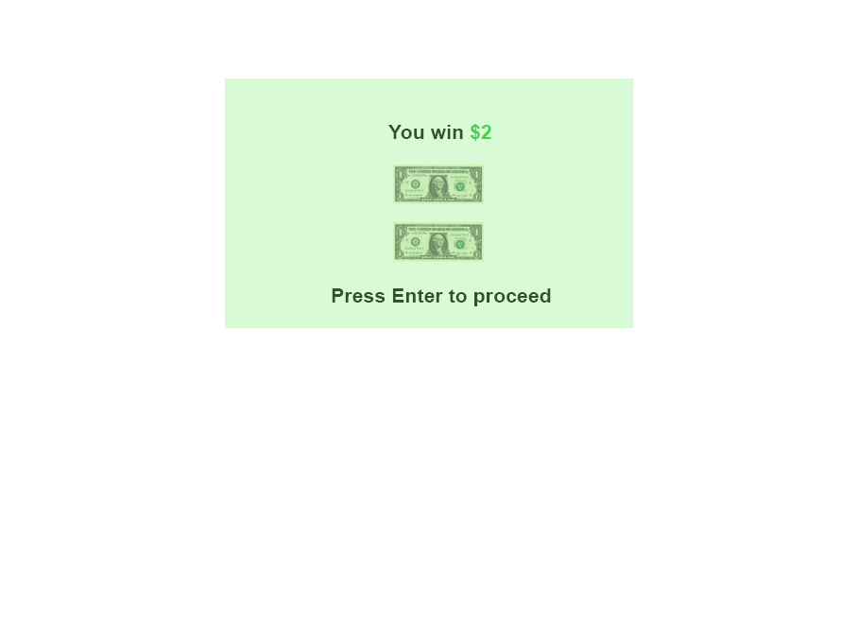

Slide 9
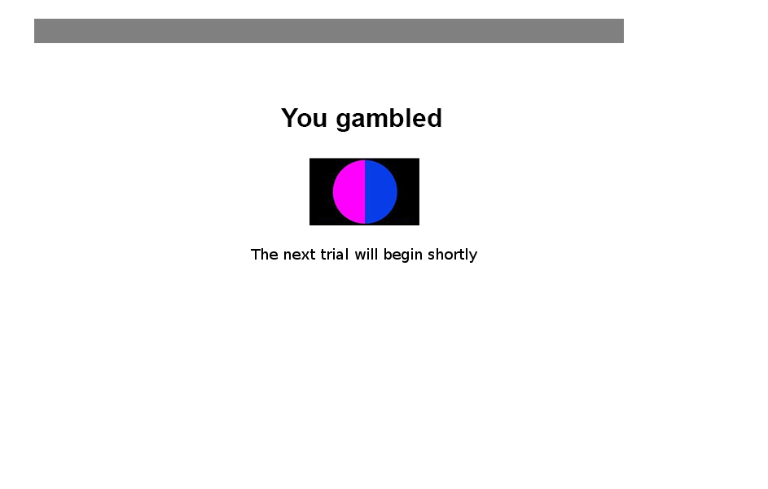
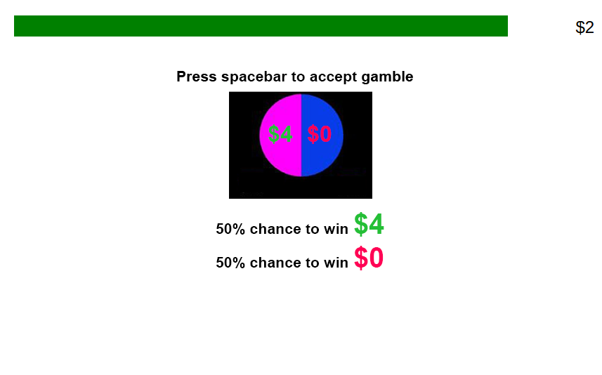

Slide 10
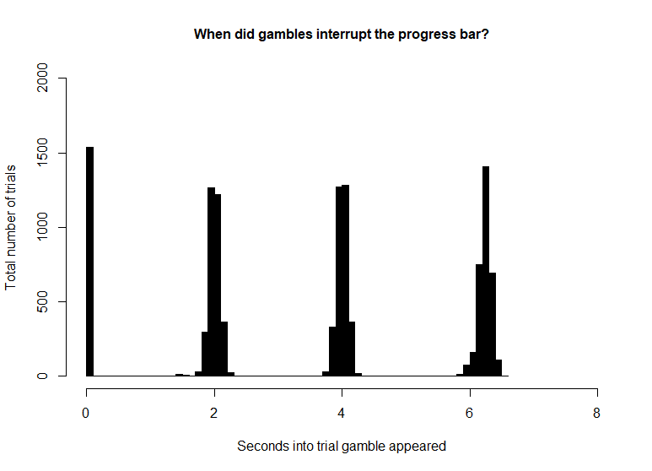
207 Participants via Amazon’s mechanical turk; (127 male; 76 female; 4 declined to answer)
141 participants analyzed
18-40 years old
133 trials (~45 minutes)
Option to gamble on 86.39 % of trials.
Gamble probablilities were always 50%
Gamble losses were always 0$
Magnitude
Low
Trials that offer $1 or $2
Mid
Trials that offer $3 or $4
High
Trials that offer $5 or $6
Value
Low
Gambles that offer 1.5* guaranteed amount
Mid
Gambles that offer 2* guaranteed amount
High
Gambles that offer 3* guaranteed amount

Slide 11
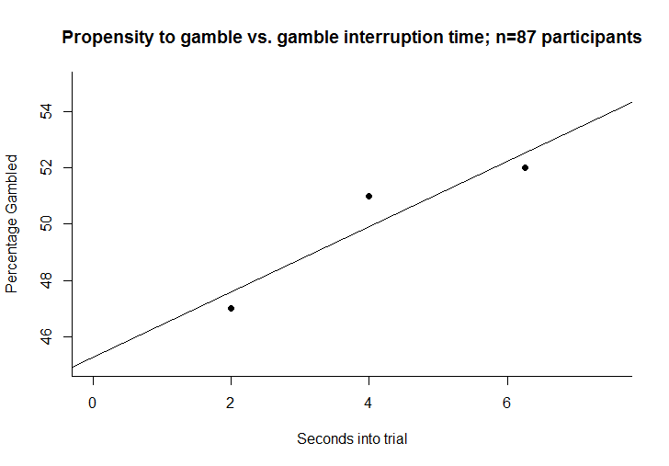
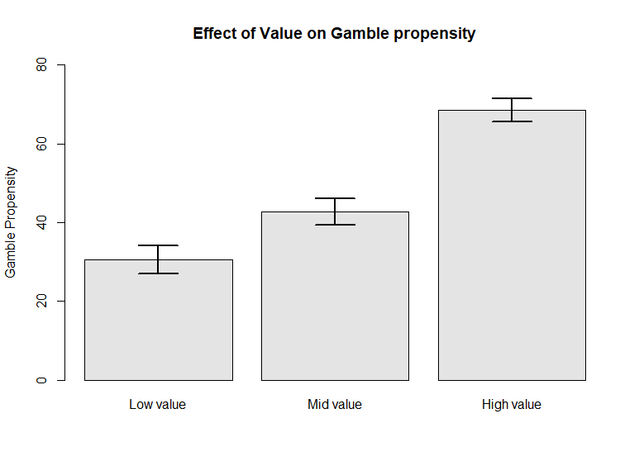
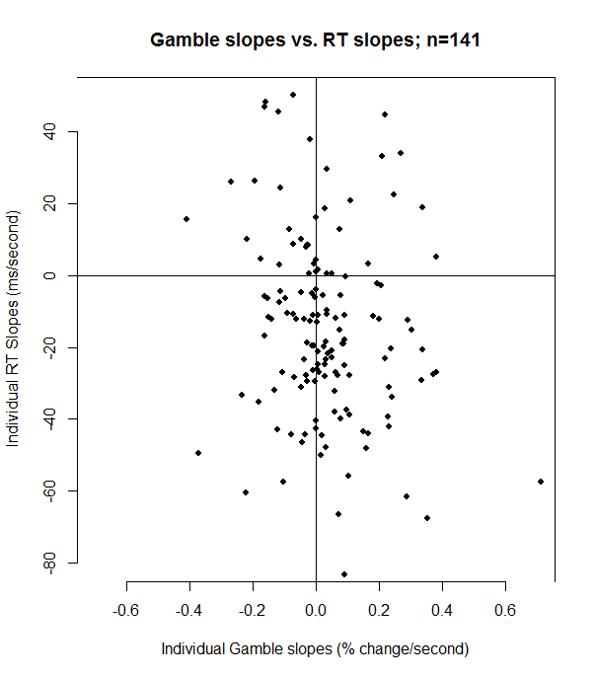
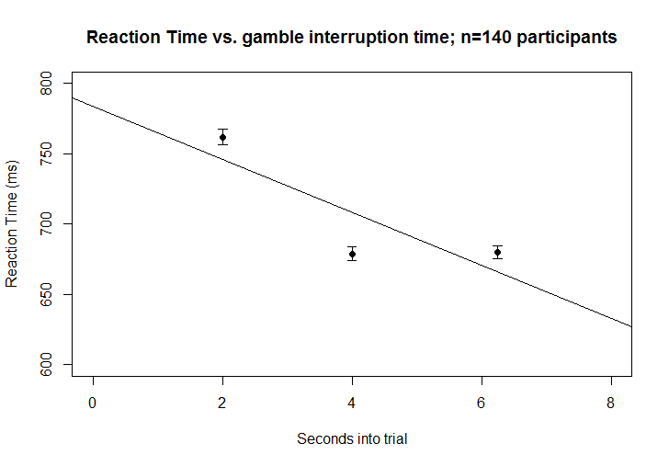
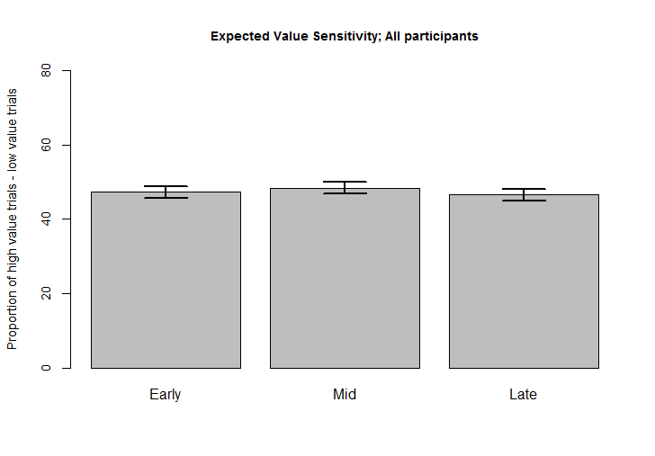
Gamble propensity vs. gamble interruption time
EV on gamble propensity
Reaction Time vs. gamble interruption time
EV sensitivity

Slide 12
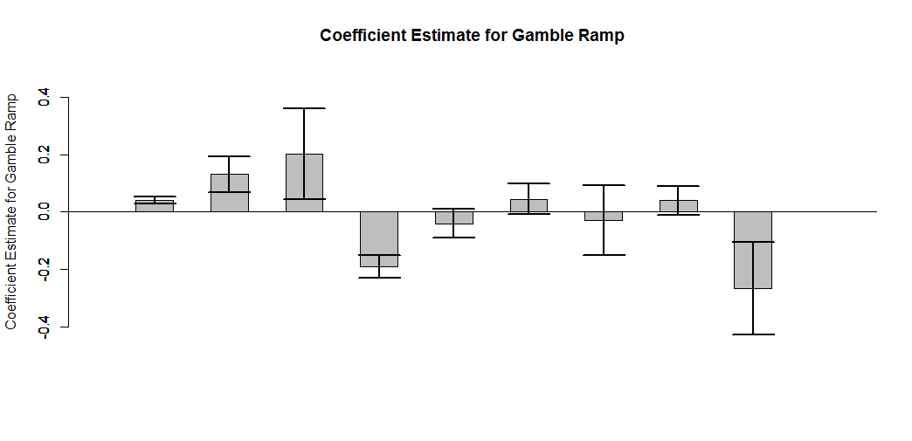
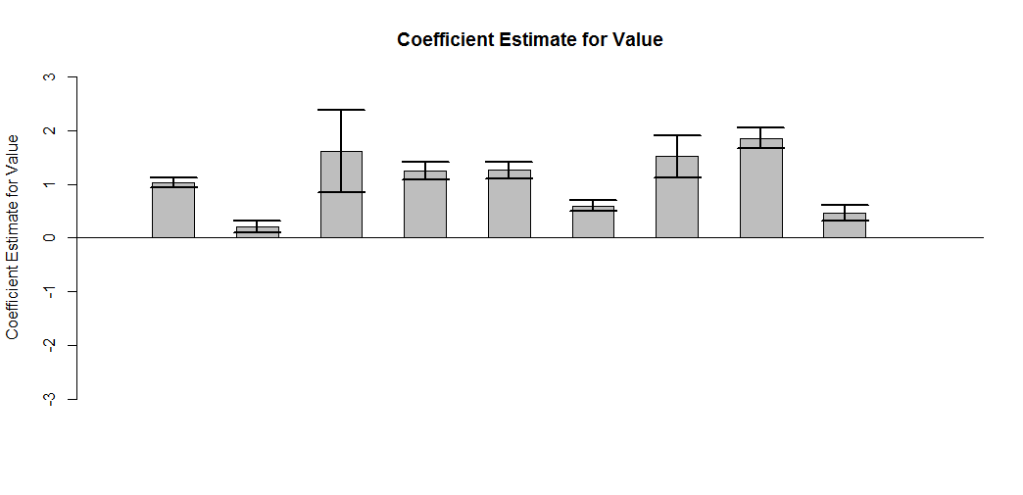
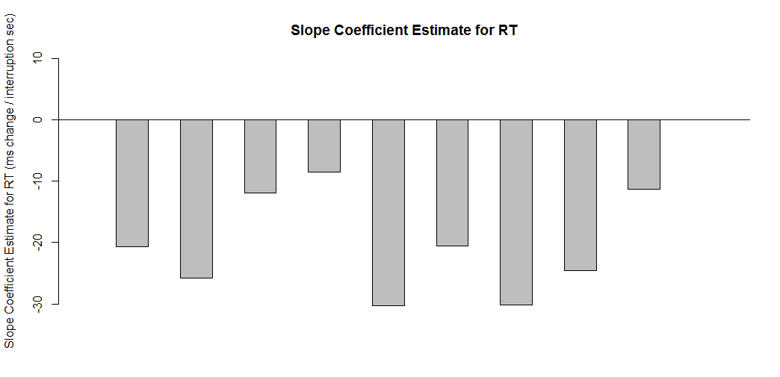
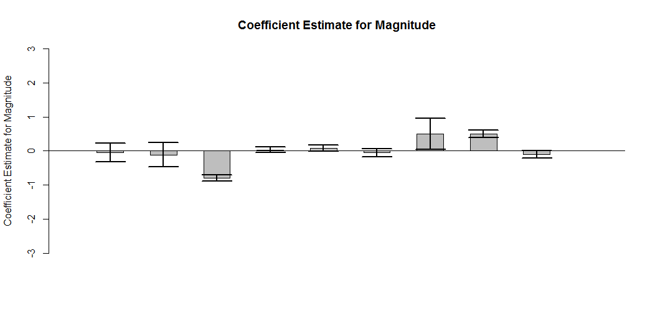
Unclear if Gamble Propensity is Affected by Gamble Interruption Time
Notes:
Version 1: preview shown for 3 seconds, 8 second progress bar
V02: Gamble preview was shorter, 1 sec shorter progress bar, some aesthetic changes, sfn shown
V03: No preview, instrumental y/n choice in 1.5 seconds
V04: Spacebar to ignore
V05: Color gamble, gamble may be colored blue (activeTrial) or orange (ignoreTrial). For blue gambles, pressing spacebar == gamble. For orange gambles, pressing spacebar == ignores gamble. Each trial’ gamble color for every participant is stochastic. Preview is 3 sec.
V06: ResponseMapping, they have to press a or l depending on which side of the screen its on.
V07: same thing but with a gamble preview of 3 sec
V08: 5 sec gamble bar, not binned anymore, press spacebar (this is now instrumental ramp)
V09: instrumental forced choice, driving progress bar forward..

Slide 13
Notes:
Very little data on humans so trying lots of things.

Slide 14
Current version
Reaction Time vs. gamble interruption time
Gamble propensity vs. gamble interruption time
Gamble slopes vs. RT slopes; n=30
EV sensitivity

Slide 15
Summary
Participants recognize advantageous and disadvantageous gambles.
Magnitude doesn’t have an effect on gambling propensity.
Participants RTs tend to decrease as the gamble interrupts later in the progress bar.
Propensity to gamble may be affected by the time at which the gamble interrupts.

Slide 16
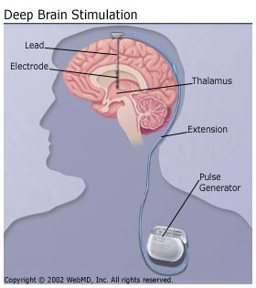
Deep Brain Stimulation (DBS) can be used to treat Parkinson’s disease
Substantia Nigra neurons degenerate
Most common medication = DA agonist
Deep Brain Stimulation (DBS) is sometimes used as a treatment to ‘lesion’ the STN
STN is implicated in recruitment of control behavior.
Notes:
Lesioning the stn with high frequency stim though it’s controversial exactly what it’s doing. High duration high frequency looks like it lesions and thus reduces the output of this global brake pedal. STN implicated in control/potentially model-free like behavior. STN = recruitment of control behavior via Wiecki and Frank 2013. Active during conflict.

Slide 17
Does STN DBS affect cost-benefit decision making?
Probably
Notes:
STN high frequency stimulation increases impulsive choice and decreases RT. Recent study showed the opposite that high frequency INCREASED RT and increased safe option. Maybe difference between intermittent and chronic? Interacting with individual differences?

Slide 18
Using eye blink rate to gauge network activity
Increased DA more eye blinks
Manipulate frequency and amplitude of DBS to capture largest effect on blink rate
Use resulting parameters during cost-benefit decision making task
Bologna et al., 2012
Notes:
Dopamine and eye blink rate are related. Lots of other things affect eye blink rate too though. The idea is to see which parameters affect eye blink rate the most (assuming that’s the biggest effect) and then use those parameters during a gambling task.

Slide 19
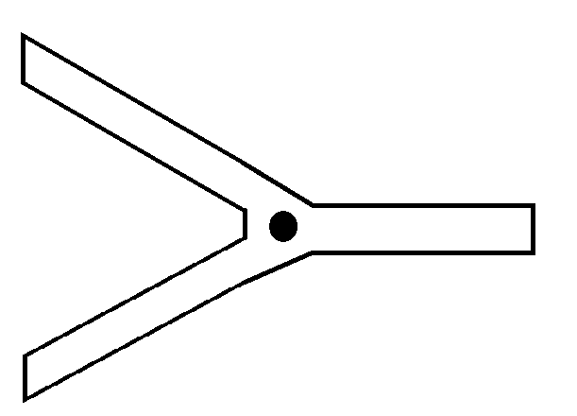
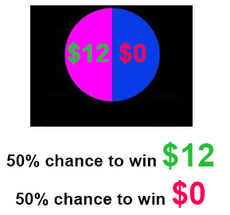
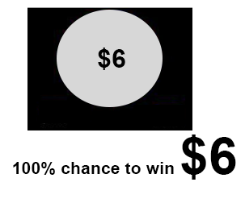
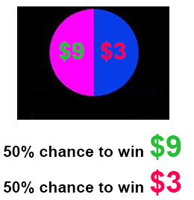
Probing cost-benefit behavior during STN stimulation
Notes:
Use a task that quantifies risk-taking behavior AND motor output.

Slide 20
Acknowledgements
Thank you…

Slide 21
Instrumental Ramp version 2: forced choice 4.13.19
40 Participants - 30 useable

Slide 22
Facts about instrumentalRampV02
5 second progress bar. Alternate A and D to drive progress bar forward.
Gamble is not previewed
Gamble is offered for a 1800 ms window sometime during the progress bar
Gamble shows up in the center of the screen, they have to answer – up arrow to gamble, down arrow ignore.
Progress bar pauses during gamble.
At the end of the progress bar participants MUST press spacebar, to either accept sure thing or confirm gamble.

Slide 23
Reason for attrition
40 completed participants
6 participants had suspiciously fast RTs
4 participants ignored every trial and never gambled.
A gambleDelay of 0 means no gamble was offered in the trial.

Slide 24
Behavioral data

Slide 26
Low Mag

Slide 27
Mid Mag

Slide 28
High Mag

Slide 29
Low value

Slide 30
Mid Value

Slide 31
High Value

Slide 32
Participants who didn’t try to blindly press buttons and did the task as they were supposed to i.e. responsibleN

Slide 33
Participants who gamble between 40% and 60%

Slide 34
Thanks!

